Slide 1


Prediction of
GROUP4:
Sushant Burde | Swarnim Jambhule | Kathryn Mak
Pratik Parmar | Monish Phatarpekar | Smit Shiroya
Notes:
KAY Pesentation (4pm, Aug 6th Tuesday)
Presentation Schedule: 4pm - 5:40pm (at Zoom, Aug 6 Tuesday)
20 mins (= 15 mins presentation + 5 min Q&A)
Due to add your presentation slide to your github and email the url address to the instructor (3:45pm, Aug 6).
Group 4: 5:00 - 5:20pm

Slide 2

Outline… ...
Abstract
Introduction
Background
Data & Methodology
Visualizations
Conclusion
References
Notes:
KAY

Slide 3

Abstract
In this work, we use Neural Networks, to predict one of the cryptocurrency price
(Bitcoin). In order to develop a better understanding on its price influencers and the general vision, based on the past data using neural network and using kibana to do visualization.
Notes:
KAY

Slide 4

Introduction - cont’
Since then, cryptocurrencies have gone from being academic concept, niche technological curiosities to rapidly proliferating financial instruments that are the subject of intense public interest. Cryptocurrencies have been sold to investors to raise funding through initial coin offerings (ICOs), and the terms of certain derivatives are now based on cryptocurrencies.
Notes:
KAY A cryptocurrency is a digital money designed to work as a medium of exchange in an electronic payment system in which payments are validated by a decentralized network of system users and cryptographic protocols instead of by a centralized intermediary (such as a bank or government). Bitcoin introduced itself as a system that solved the Double Spend problem (Nakamoto, 2008). Since then, cryptocurrencies have gone from being academic concept, niche technological curiosities to rapidly proliferating financial instruments that are the subject of intense public interest. Recently, they have been incorporated into a variety of other financial transactions and products.

Slide 5
Background
The world of cryptocurrency and blockchain are constantly evolving. As one of the most valuable virtual currency that is completely paperless and autonomous. For centuries, people rely on printed money as the major medium of transacting business. The nature by which cryptocurrency work makes the system less prone to human errors and malicious activities.
Notes:
MONISH The world of cryptocurrency and blockchain are constantly evolving and fascinating to many. As one of the most valuable virtual currency that is completely paperless and autonomous, Bitcoin has been the topic of discussion among financial investors, stock traders, software programmers, and the public in general. For centuries in history, people rely on printed money as the major medium of transacting business. The nature by which cryptocurrency work makes the system less prone to human errors and malicious activities.
The system of cryptocurrency as a form of digital money is based upon the idea of blockchain, which can be understood as a ledger that is publicly available and can be monitored simultaneously by hundreds of computer users. The information contained within these blockchains can be verified among the public, thus potentially bypassing a centralized system operated by banks and other financial institutions. The Bitcoin, the Ethereum, and other similar cryptocurrencies presented a relatively volatile fluctuation in its face value. Over time, the market favored a rise in the values of these digital currencies. Although some financial and academic leaders have raised concerns to the reliability of the cryptocurrency system, further research is required to better understand and improve any shortcomings of the cryptocurrency and blockchain system.

Slide 6
Background - cont’
The system of cryptocurrency as a form of digital money is based upon the idea of blockchain, which can be understood as a ledger that is publicly available and can be monitored simultaneously by hundreds of computer users. Thus, potentially bypassing a centralized system operated by banks and other financial institutions. The Bitcoin, the Ethereum, and other similar cryptocurrencies presented a
Notes:
MONISH The world of cryptocurrency and blockchain are constantly evolving and fascinating to many. As one of the most valuable virtual currency that is completely paperless and autonomous, Bitcoin has been the topic of discussion among financial investors, stock traders, software programmers, and the public in general. For centuries in history, people rely on printed money as the major medium of transacting business. The nature by which cryptocurrency work makes the system less prone to human errors and malicious activities.
The system of cryptocurrency as a form of digital money is based upon the idea of blockchain, which can be understood as a ledger that is publicly available and can be monitored simultaneously by hundreds of computer users. The information contained within these blockchains can be verified among the public, thus potentially bypassing a centralized system operated by banks and other financial institutions. The Bitcoin, the Ethereum, and other similar cryptocurrencies presented a relatively volatile fluctuation in its face value. Over time, the market favored a rise in the values of these digital currencies. Although some financial and academic leaders have raised concerns to the reliability of the cryptocurrency system, further research is required to better understand and improve any shortcomings of the cryptocurrency and blockchain system.

Slide 7
Background -cont’
relatively volatile fluctuation in its face value. Over time, the market favored a rise in the values of these digital currencies. Although some financial and academic leaders have raised concerns to the reliability of the cryptocurrency system, further research is required to better understand and improve any shortcomings of the cryptocurrency and blockchain system.
Notes:
MONISH The world of cryptocurrency and blockchain are constantly evolving and fascinating to many. As one of the most valuable virtual currency that is completely paperless and autonomous, Bitcoin has been the topic of discussion among financial investors, stock traders, software programmers, and the public in general. For centuries in history, people rely on printed money as the major medium of transacting business. The nature by which cryptocurrency work makes the system less prone to human errors and malicious activities.
The system of cryptocurrency as a form of digital money is based upon the idea of blockchain, which can be understood as a ledger that is publicly available and can be monitored simultaneously by hundreds of computer users. The information contained within these blockchains can be verified among the public, thus potentially bypassing a centralized system operated by banks and other financial institutions. The Bitcoin, the Ethereum, and other similar cryptocurrencies presented a relatively volatile fluctuation in its face value. Over time, the market favored a rise in the values of these digital currencies. Although some financial and academic leaders have raised concerns to the reliability of the cryptocurrency system, further research is required to better understand and improve any shortcomings of the cryptocurrency and blockchain system.

Slide 8
SPECIFICATION : ...
System : MacOs
Processor : 2.5 GHz
Storage : 500Gb
Memory : 8 GB Ram
Kibana : Version 7.1
Jupyter : Version 6.0

Slide 9
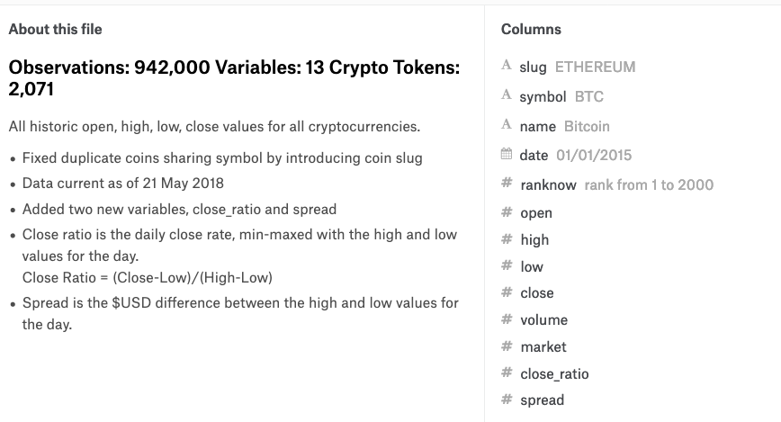
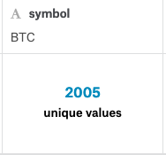
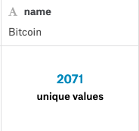
Cryptocurrency Market Data :...

Slide 10
URL...
Dataset URL: https://www.kaggle.com/jessevent/all-crypto-currencies
Data Size : 84 Mb
Github URL:
https://github.com/sburde71/CIS-5900-Group-4

Slide 11

Methodology
We are performing analysis and visualization of trending crypto currency with the help of elasticsearch and kibana and apply deep learning method using keras library and others. We will build a neural network by introducing python programming to predict the future close price of a bitcoin currency.

Slide 12
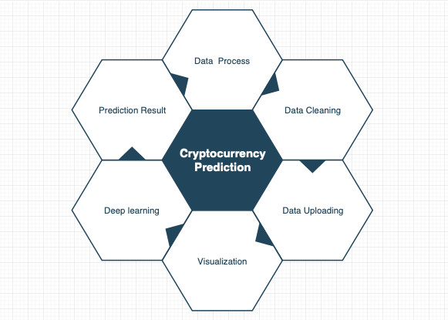
Methodology - cont’

Slide 13
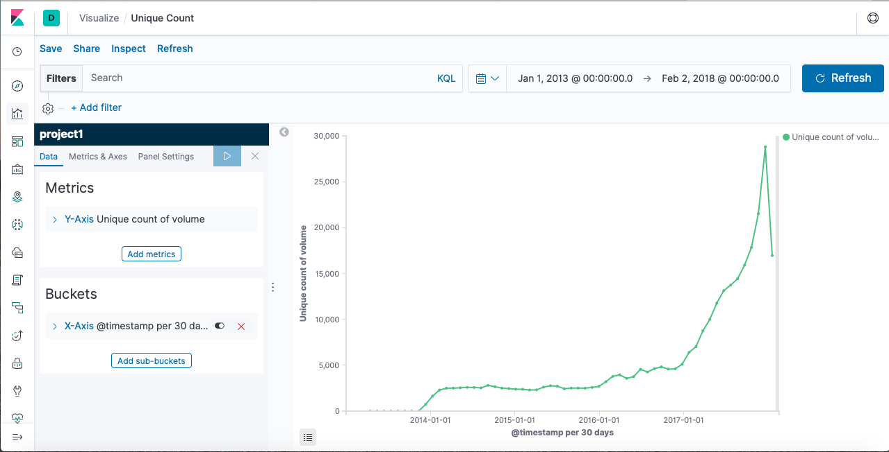
Trend Of Cryptocurrency :

Slide 14
Trend Of Cryptocurrency - cont’
Fig. Illustrates the growth rate of count of volume per year. There was a drastic increase in the amount of the volume for cryptocurrencies during 2014 to 2017. Later, sudden raise was noticed during 2018, buyers enticed to buy more amount of bitcoin.
During 2018, Market crash down which impact buyers to loses money.

Slide 15
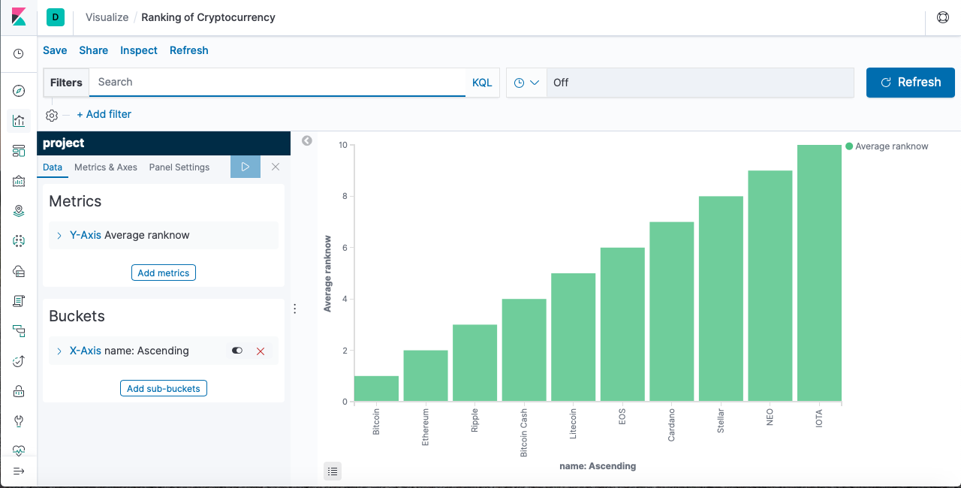
Chart: Currency Based On Rank

Slide 16
Chart: Currency Based On Rank - cont’
Chart illustrates the stock market ranking of various bitcoin available in the market. As per the record, bitcoin lead the market with a significant jump in stock market makes buyers to entice more during the time period.
The average price for bitcoin jumped over 10K dollars which makes difficult other stock to increase their prices. The IOTA and NEO still struggling to achieve the spot in the marketplace. Bitcoin and Ethereum popularity makes them continue to stay at the top spot.

Slide 17
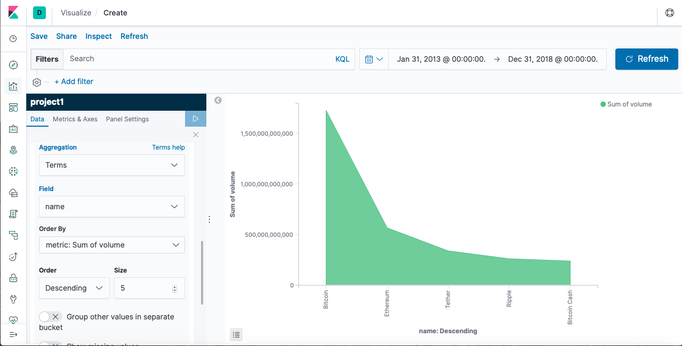
Chart: Currency Based On Volume

Slide 18
Chart: Currency Based On Volume- cont’
Fig shows the overall volume of stock market leading cryptocurrencies. The bitcoin prices rising heavily makes buyer to buy more stock. There were over 1.5B stock recorded for FY 2013 to 2018.
Ripple and bitcoin cash struggles to make above average. The volume rate changes according to bitcoin price changes which affects other to increase their prices as well. Probably, the prices for bitcoin was predicted to cross over 13K/ per stock which definitely crash the stock market.

Slide 19
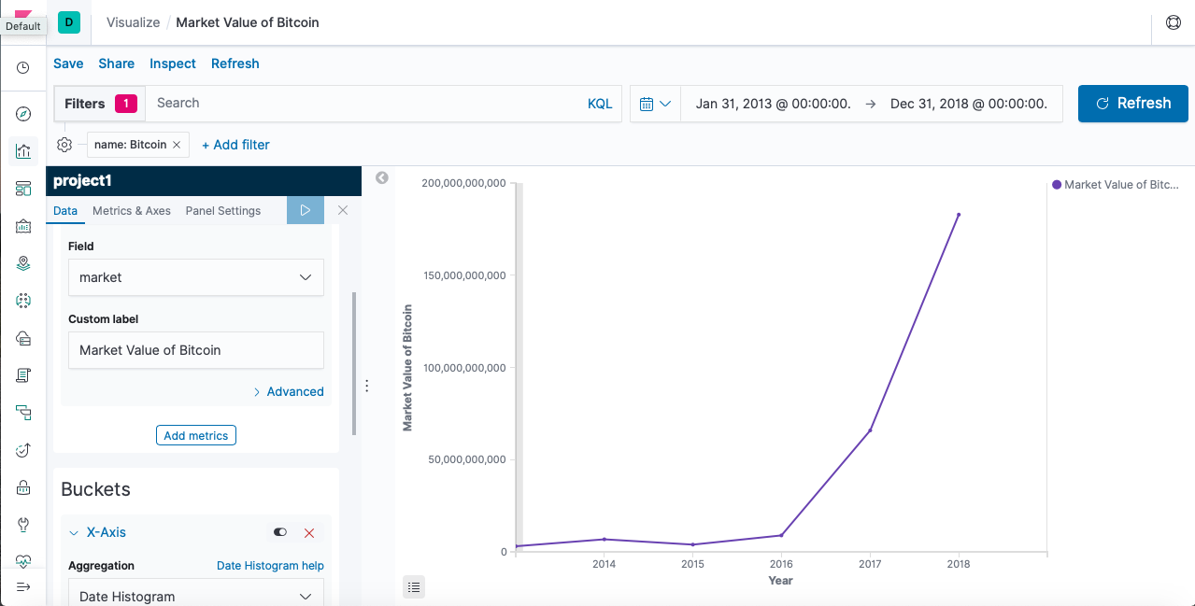
Market Value Of Bitcoin 2013 - 2018

Slide 20
Market Value Of Bitcoin 2013 - 2018 cont’
Industry sectors are emerging with rapid growth rate producing scalable and flexible products and providing quality services. This attracts more customers and partner to get interest. People nowadays buying many stocks and making lot of money out of it.
Similarly, Bitcoin is attracting many people to buy its stock. As per the chart, over 17B market value of bitcoin was recorded during 2018. The growth rate was over 90% since 2016.

Slide 21
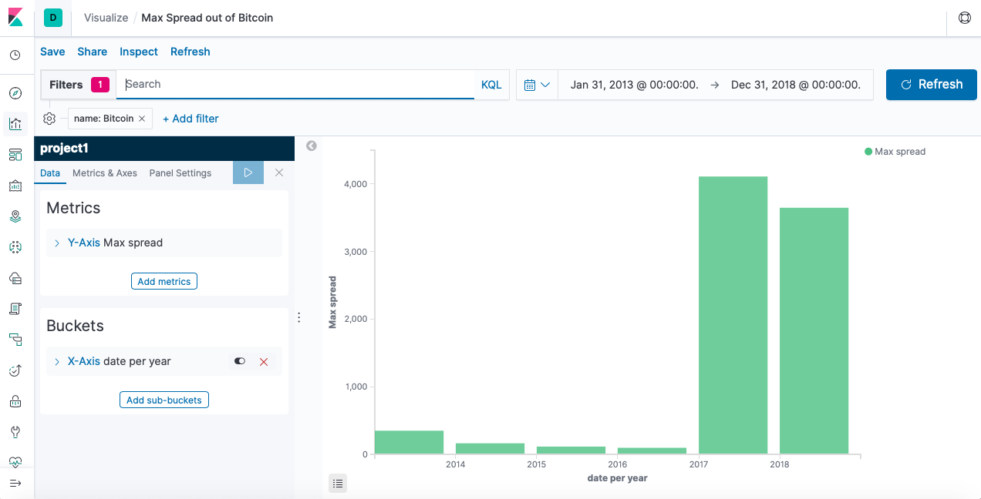
Max Spread out Of Bitcoin 2013 - 2018

Slide 22
Max Spread out Of Bitcoin 2013 - 2018 cont’
While no one is entirely sure how Bitcoin will continue to spread to the larger financial world, it seems likely that a limited supply of the currency may cause prices to continue to increase.
During 2017, Max spread was nearly 4k and supply of currency was fall during 2018 which make the spread fall to 75%.

Slide 23
Applying Deep Learning to predict “Bitcoin”
Applying Deep learning to predict currency (“Bitcoin”) :
From the dataset we extract the bitcoin data and applied deep learning with the help of python programming.
Libraries: Numpy, Pandas , Sklearn , Keras
Using jupyter platform and with the help python libraries we trained our dataset with 150 epochs and build a neural network using LSTM architecture and adam optimizing algorithm.

Slide 24
Applying Deep Learning to predict “Bitcoin”
In the programming we have also used sigmoid function, The main reason why we use sigmoid function is because it exists between (0 to 1). Therefore, it is especially used for models where we have to predict the probability as an output.Since probability of anything exists only between the range of 0 and 1, sigmoid is the right choice.
When we compare the results with the original one we can see that we have better prediction with LSTM.

Slide 25
Understanding LSTM
Theoretically the naively connected neural network, so called recurrent neural network, can work. But in practice, it suffers from two problems: vanishing gradient and exploding gradient, which make it unusable.
LSTM (long short term memory) was invented to solve this issue by explicitly introducing a memory unit, called the cell into the network.
Long short-term memory (LSTM) is an artificial recurrent neural network (RNN) architecture used in the field of deep

Slide 26
Understanding LSTM
learning. A common LSTM unit is composed of a cell, an input gate, an output gate and a forget gate. The cell remembers values over arbitrary time intervals and the three gates regulate the flow of information into and out of the cell. LSTM networks are well-suited to classifying, processing and making predictions. LSTMs were developed to deal with the exploding and vanishing gradient problems that can be encountered when training traditional RNNs.

Slide 27
Understanding LSTM
LSTMs contain information outside the normal flow of the recurrent network in a gated cell. Information can be stored in, written to, or read from a cell, much like data in a computer’s memory.The cell makes decisions about what to store, and when to allow reads, writes and erasures, via gates that open and close.
Those gates act on the signals they receive, and similar to the neural network’s nodes, they block or pass on

Slide 28
Understanding LSTM - cont’
information based on its strength and import, which they filter with their own sets of weights.
Those weights, like the weights that modulate input and hidden states, are adjusted via the recurrent networks learning process. That is, the cells learn when to allow data to enter, leave or be deleted through the iterative process of making guesses, backpropagating error, and adjusting weights via gradient descent.

Slide 29
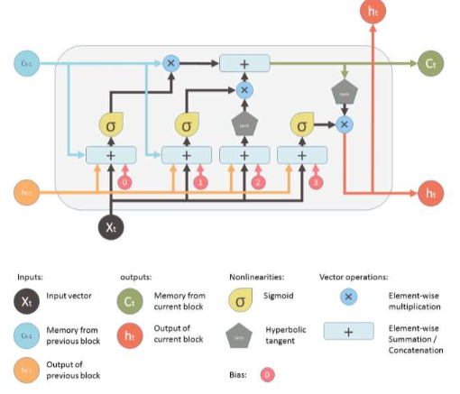
Architecture of LSTM Network :

Slide 30
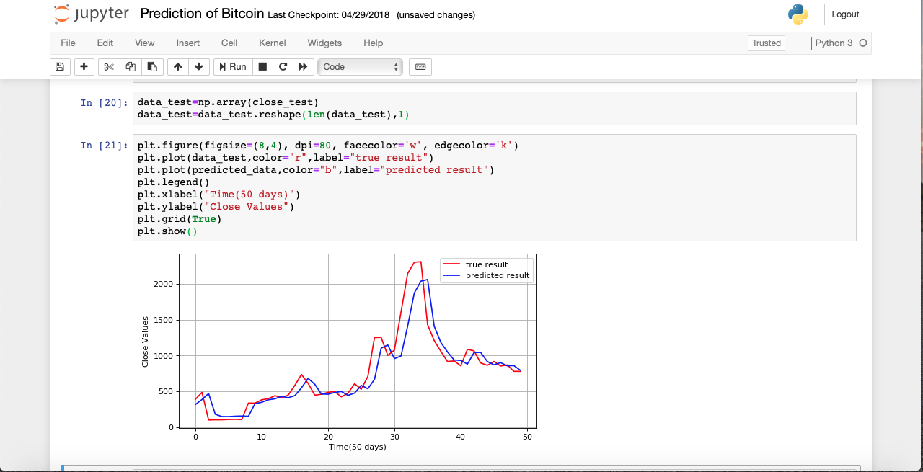
Output :

Slide 31
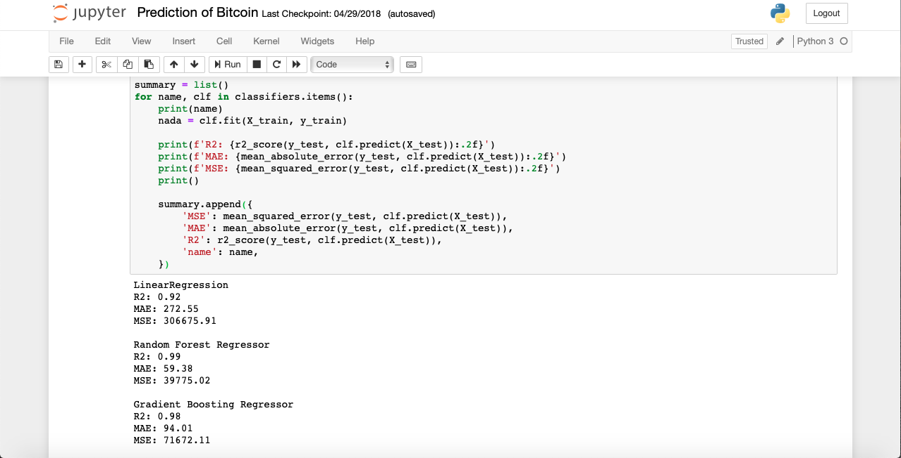
Output :

Slide 32

Conclusion :
Based on the market from the year 2013 to 2018 we analysed and predicted the cryptocurrency based on the past data which help us to determine the future price of any cryptocurrency by building neural network.
Notes:
Use this website ---> www.citationmachine.net/

Slide 33
References :
A Beginner's Guide to LSTMs and Recurrent Neural Networks. (n.d.). Retrieved from https://skymind.ai/wiki/lstm
Yan, S. (2017, November 15). Understanding LSTM and its diagrams. Retrieved from https://medium.com/mlreview/understanding-lstm-and-its-diagrams-37e2f46f1714
Notes:
Use this website ---> www.citationmachine.net/

Slide 34


Any Question ?
Thank
You !
Team 4

